Slide 1
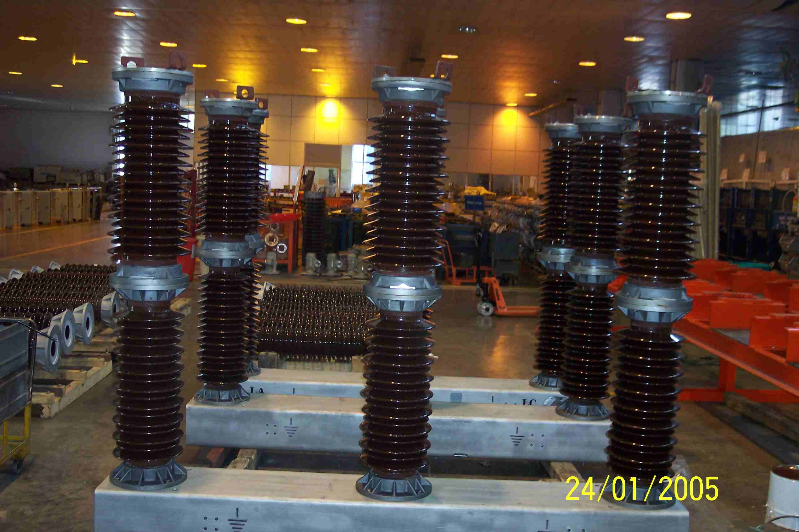
SIEMENS
HVCB SPARES
Complete pole , 72.5KV, 31.5KA CB
S4809235001

